Slide 1

Aimable MUNYESHAKA
Umwanditsi wa code muri egeraTech

Slide 2
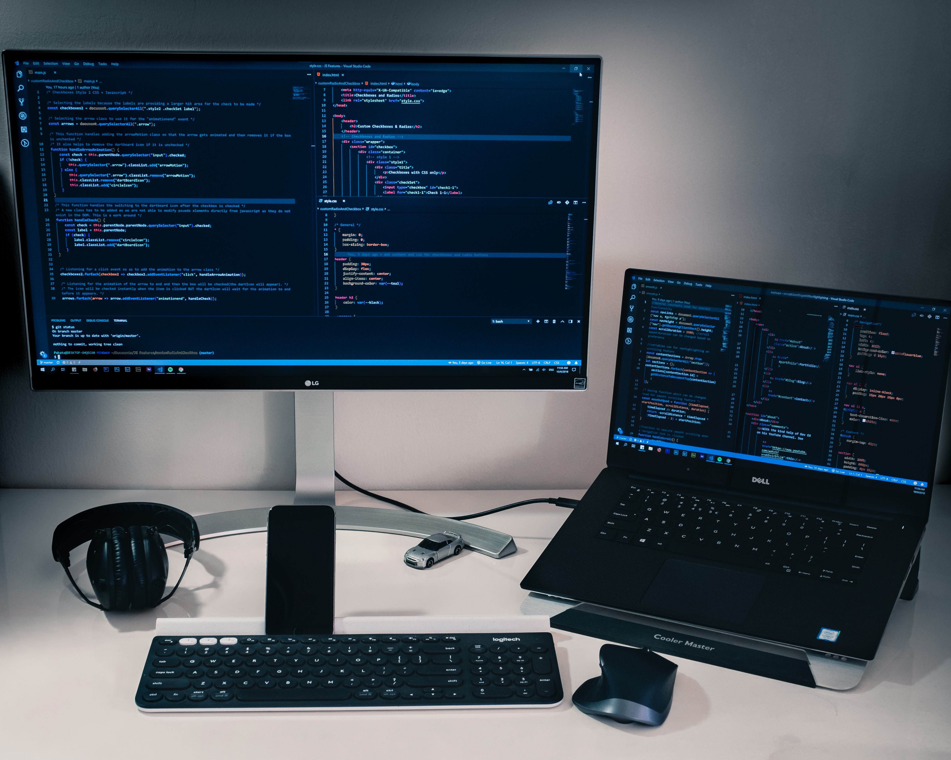
What Is Programming??
Programming is the process of creating a set of instructions that tell a computer how to perform a task.
“Do this; then do that.”
“If this condition is true, perform this action; otherwise, do that action.”
“Do this action that number of times.”
“Keep doing that until this condition is true.”

Slide 3
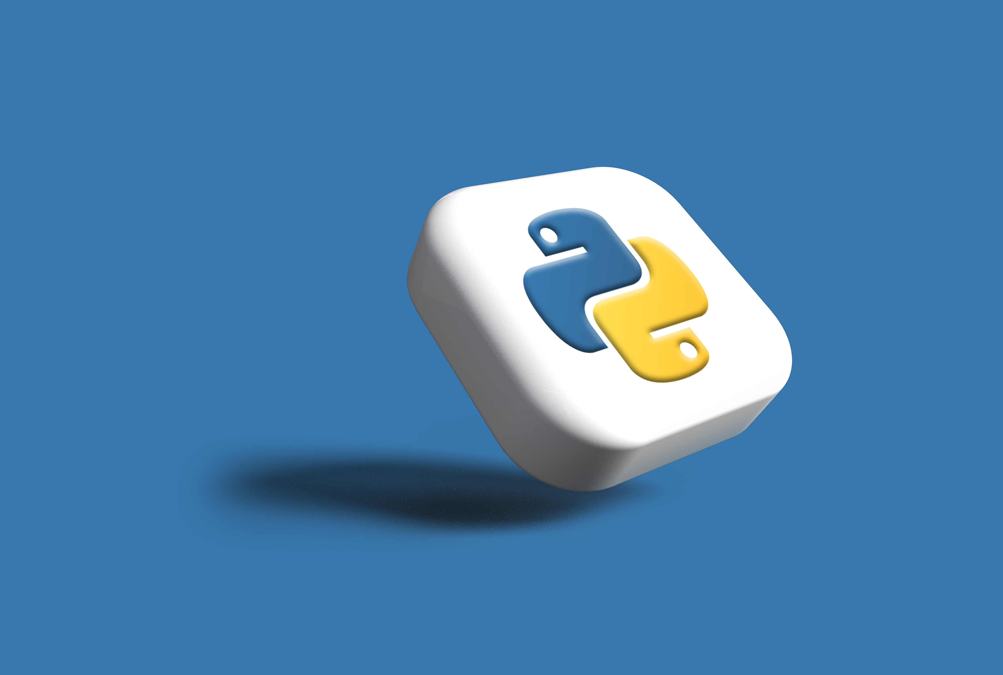
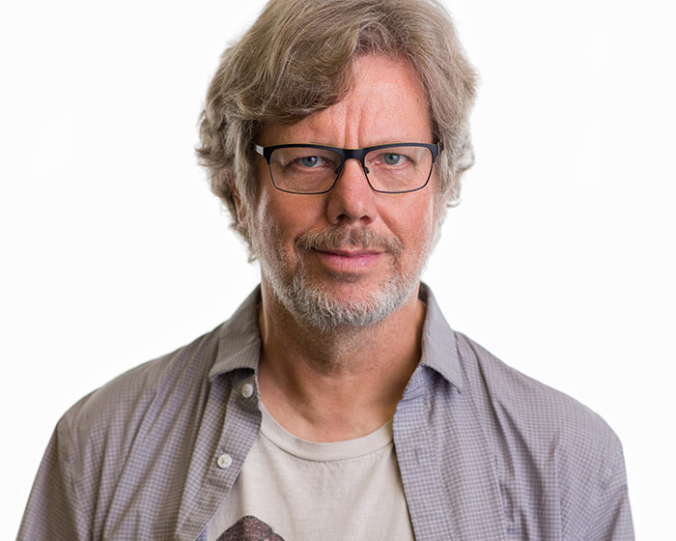
What is Python??
Python is a programming language that allows us to give instructions to computers. It's like giving commands to a robot or telling a story to a friend, but in a special language that computers understand
It was created by Guido van Rossum during 1985- 1990.

Slide 4


Python for do what??
With Python, we can create:
- our own programs and make things happen on the computer.
- We can build games,
- create art,
solve puzzles,
Application,
- and even make websites

Slide 5
Why Python??
Python is a great language for kids because
it's easy to learn and understand.
The commands in Python are written in a way that looks like English words,
so it's not as complicated as other programming languages

Slide 6
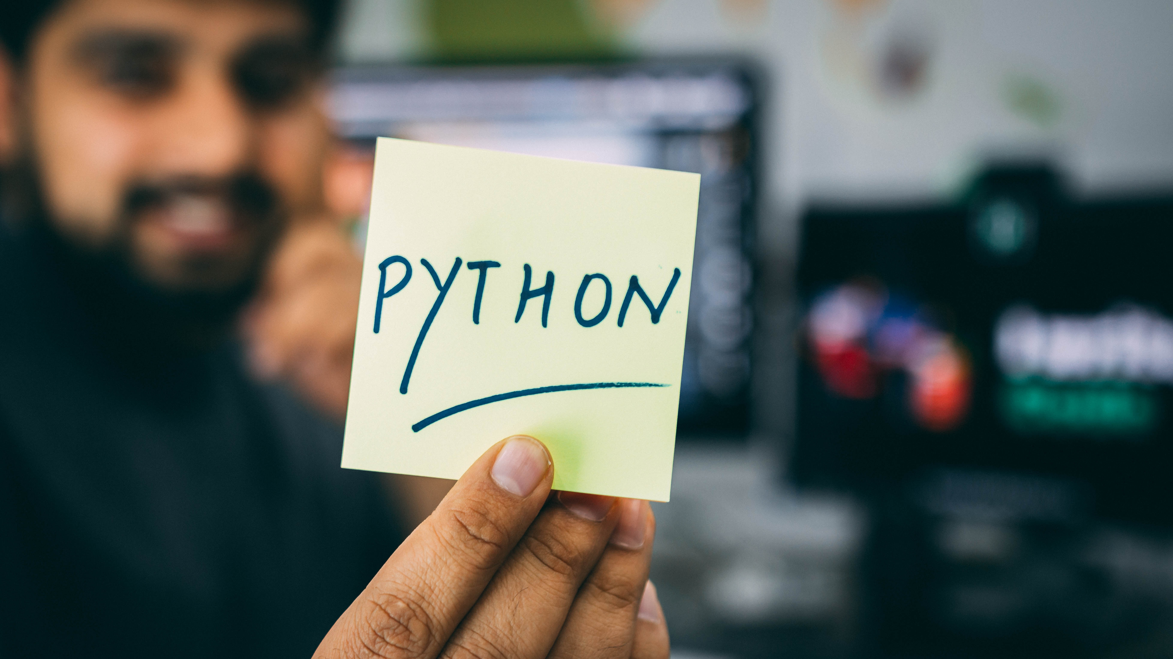
Why Python??
Learning Python helps us develop problem-solving skills and logical thinking. It allows us to be creative and curious, and it gives us the power to create things using technology

Slide 7
Why to Learn Python?
Python is Open Source which means its available free of cost.
Python is simple and so easy to learn
Python is versatile and can be used to create many different things.
Python has powerful development libraries include AI, ML etc.
Python is much in demand and ensures high salary

Slide 8
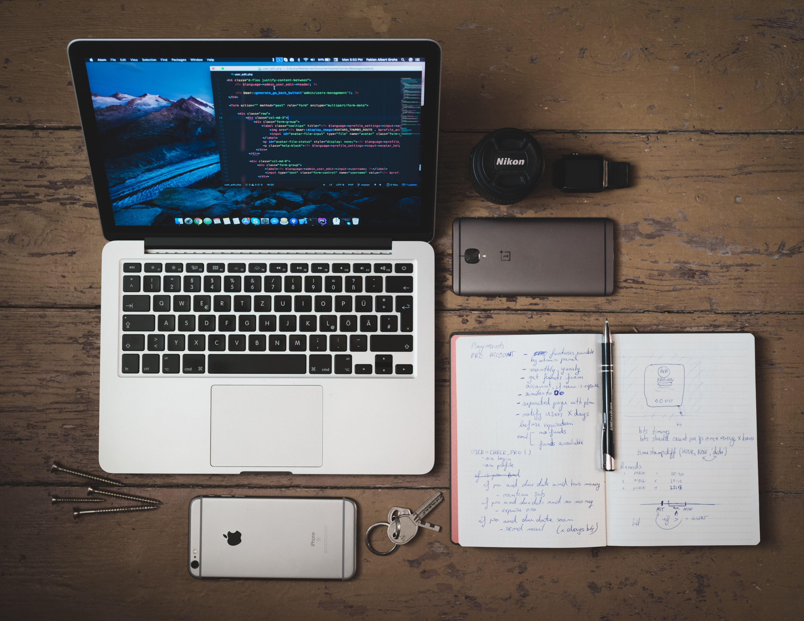
Get Start Python
Download and install Python

Slide 9
Basic Syntax
The basic syntax includes:
variables,
comments,
data types,
operators,
decision making,
loops,
and functions

Slide 10
Variables
How to declare and use variables in Python, including naming conventions
Case Sensitivity: Python is case-sensitive, which means that uppercase and lowercase letters are considered different. For example, "myVariable" and "myvariable" are treated as two different variables
- myVariable, myvariable, my_variable, myvariable2

Slide 11
Comments
It covers how to add comments in Python code to make it more readable and understandable

Slide 12
Operators
The various operators in Python, including
Arithmetic: +-*/
Comparison: =, >, <, <=, >=, ==, !=
Logical: True, False
assignment operators: =, +=, -=, /=

Slide 13
Data Types
It covers the different data types in Python, such as numbers, strings, lists, tuples, and dictionaries

Slide 14
Decision Making
It covers the if-else and switch-case statements for making decisions in Python

Slide 15
Loops
The tutorial explains the for and while loops for iterating over sequences and performing repetitive tasks

Slide 16
Numbers
It covers the different types of numbers in Python, such as integers, floating-point numbers, and complex numbers

Slide 17
Strings
The tutorial explains how to work with strings in Python, including string concatenation, slicing, and formatting

Slide 18
Lists
It covers the creation, manipulation, and accessing of lists, which are ordered collections of items in Python

Slide 19
Tuples
The tutorial explains how to create and use tuples, which are similar to lists but are immutable

Slide 20
Dictionary
It covers the creation and usage of dictionaries, which are key-value pairs in Python

Slide 21
Functions
The tutorial explains how to define and use functions in Python to organize code and perform specific tasks

Slide 22
Date & Time
It covers how to work with dates and times in Python using the datetime module

Slide 23
Modules
It covers how to use modules in Python to extend the functionality of your programs

Slide 24
Files I/O
The tutorial explains how to read from and write to files in Python using file handling operations

Slide 25
Exceptions
It covers how to handle exceptions and errors in Python using try-except blocks

Slide 26
Happy Coding

